Slide 1

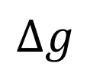


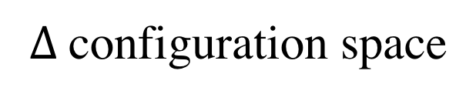
$$∆s$$
$$δ=0.1$$
$$δ=0.1$$
$$∆g$$
$∆$configuration space

